Slide 1

Workshop Housekeeping Python Fundamentals for Engineers and Manufacturers

Slide 2
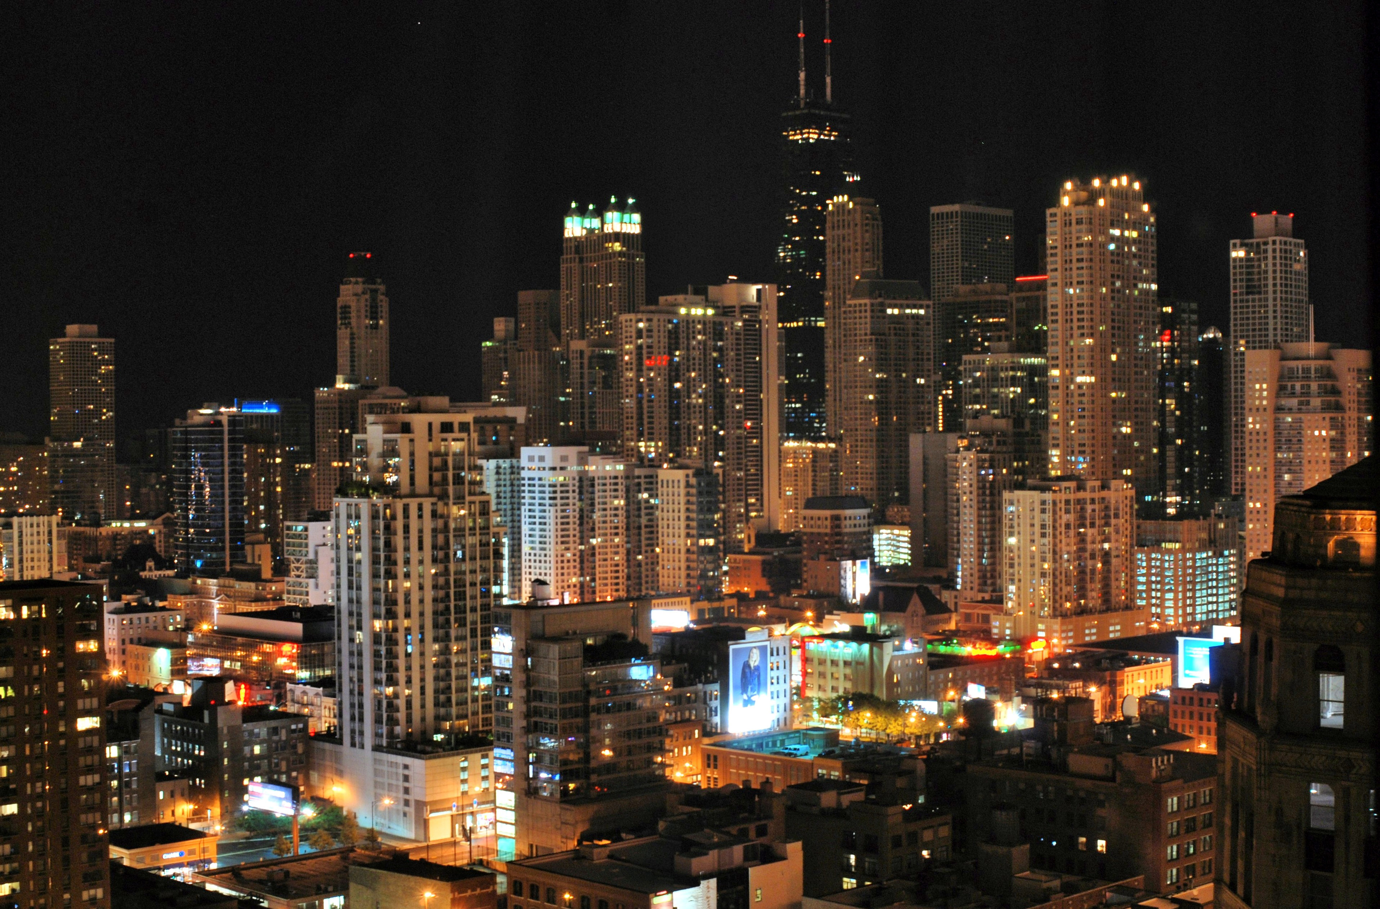
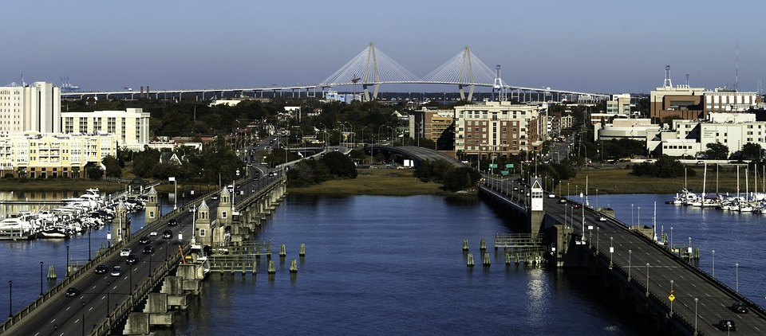
Hosted By
Workshop repo
http://bit.ly/2opFlZ6
SME Chapter 112
Chicagoland
SME Chapter 430
Greater Charleston

Slide 3
Where is all the info for this workshop?
http://bit.ly/2opFlZ6
All code is licensed under The MIT License.
All written content is licensed under Creative Commons Attribution 4.0 International Public License.

Slide 4
Workshops are just the beginning.
Workshop repo
http://bit.ly/2opFlZ6
Open-source projects on GitHub
Targeted webinars on YouTube
Real-world, industry use-cases on YouTube
Industrial hardware/software hackathons
Virtual assistance with SME student chapter projects.

Slide 5
Feedback
Workshop repo
http://bit.ly/2opFlZ6
We
feedback and suggestions!
http://bit.ly/2G42GXy

Slide 6
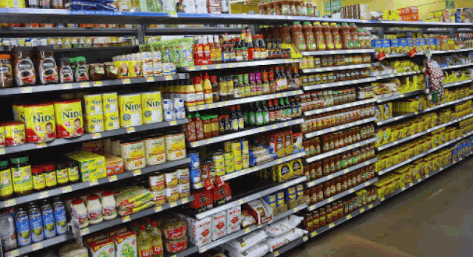
Robot Operating System http://www.ros.org/
OpenCV
https://opencv.org/
CUDA
http://bit.ly/2F9tpkH
NVIDIA Jetson Boards
http://bit.ly/2FOnx1f

Slide 7
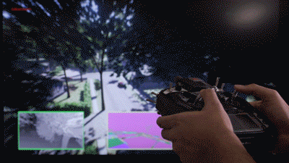
PX4 – Flight Stack and Autonomous Middleware
http://px4.io/

Slide 8
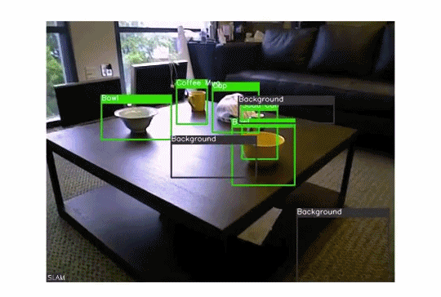
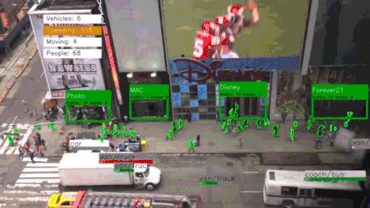
OpenCV
https://opencv.org/
NVIDIA Jetson Boards
http://bit.ly/2FOnx1f

Slide 9
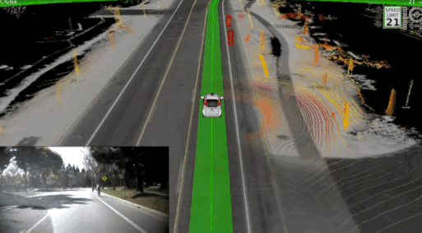
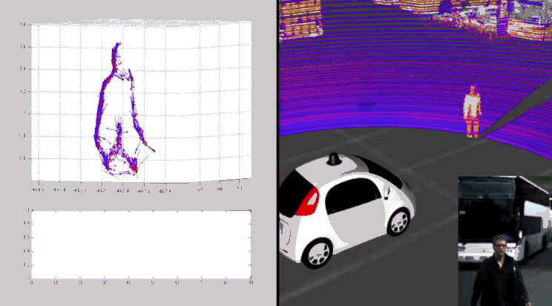
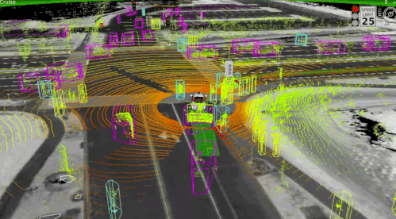
CARLA
http://www.carla.org/
Udacity Self-Driving Simulator
http://bit.ly/2oKNKFY
Unity
https://unity3d.com/

Slide 10
Workshop Outline – Day 1
Workshop repo
http://bit.ly/2opFlZ6
Introduction to Git.
Introduction to the Python interpreter and pip ecosystem.
Introduction to Jupyter Notebooks.
Data types and objects.
Reading and writing data.
Control flow.
Loops and iterables.
Functions.
Classes.
Packages.
There will be do-it-yourself challenges throughout!

Slide 11
Workshop Outline – Day 2
Workshop repo
http://bit.ly/2opFlZ6
Documentation.
Testing.
Debugging.
Profiling.
Network communication.
Data exploration and visualization (with NumPy and Pandas).
There will be do-it-yourself challenges throughout!

Slide 12
Workshop Outline – Day 3
Workshop repo
http://bit.ly/2opFlZ6
Concurrency and parallelism.
Hardware description and verification (HDL).
Computational geometry (pretty good video here).
Image manipulation and machine vision.
Neural networks (CNN or ConvNet).
Check out the TensorFlow Playground.
There will be do-it-yourself challenges throughout!

